Slide 1
ITSC 200 – Network Protocols and Security
Cybera RAC - VPN

Slide 2
Goal
Establish a virtual private network (VPN) between your computer and a VPN service within Cybera.
This will allow you to access the private IP address of instances associated with your project.
No need for a floating IP!

Slide 3
What you will need
Cybera OpenVPN Configuration Files
http://vpn-yyc.cloud.cybera.ca/vpn-yyc-win.zip
OpenVPN
https://openvpn.net/community-downloads/

Slide 4
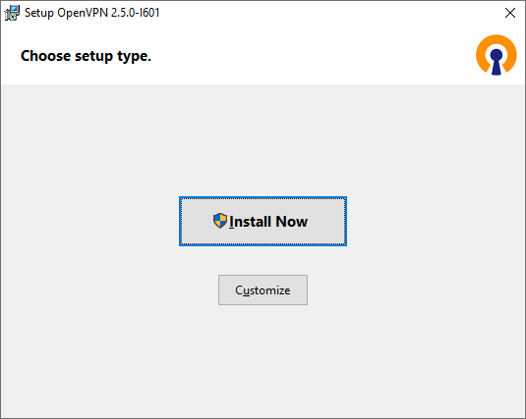
Installing OpenVPN
OpenVPN
Windows 64-bit Installer

Slide 5
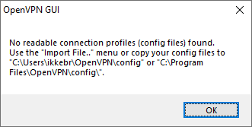
Installing OpenVPN
Don’t worry if you get an error message!
You still need to configure the VPN.

Slide 6
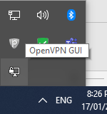
Is OpenVPN running?
Check your taskbar for the OpenVPN GUI icon

Slide 7
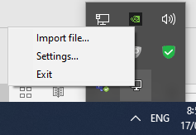
Is OpenVPN running?
If you right-click on the OpenVPN GUI icon you should see three options:

Slide 8
OpenVPN Configuration Files
These tell OpenVPN how to behave, where to connect and which entities to trust.
Extract the contents of the zip file to a folder.
Recommended location is C:/Users/yourusername/OpenVPN/config/client
It should contain 4 files
ca.crt
client.crt
client.key
client.ovpn

Slide 9
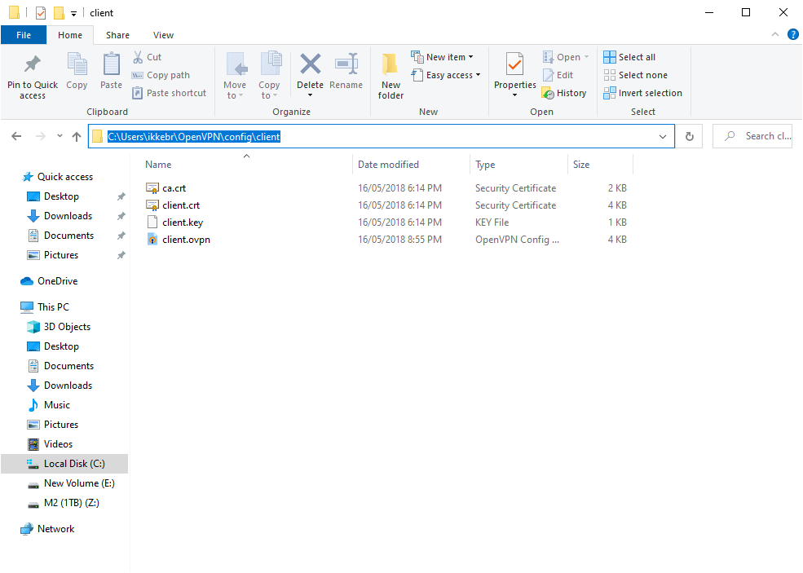
OpenVPN Configuration Files

Slide 10
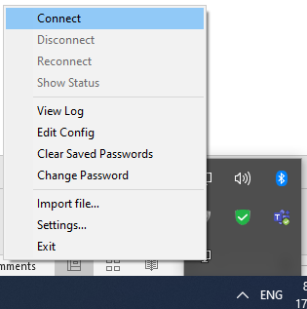
Connecting to the VPN
Right-click on the OpenVPN GUI icon
Click “Connect”

Slide 11
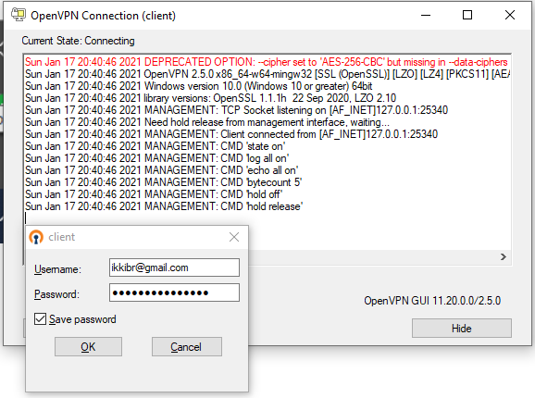
Connecting to the VPN
You will be prompted for a username and password
Use your Cybera Account Login and Password

Slide 12
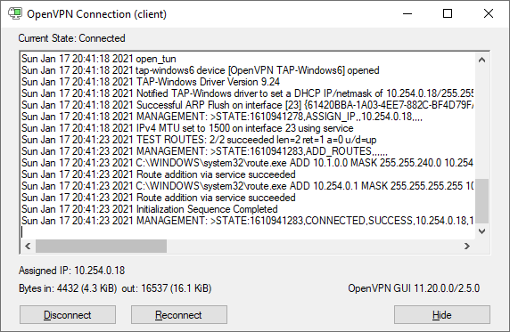
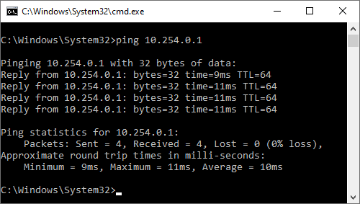
You are connected to the VPN!
If everything went OK, the icon will turn Green and you will be able to to ping 10.254.0.1

Slide 13
Now you can connect to your
Now you can use Putty or the native ssh client to connect to the private ip of your instance!

Slide 14
Done

